Slide 1

Video Game Sales
A data analysis project by:
Nick Hammer

Slide 2
CLEANING OUR DATA
Our data set contains 16,598 unique items. Each item in our data set shows the title of a video game, the platform for which it was released on, the year that the title was released, the company that published the title, the genre of the game, and the total sales of the title in North America, Europe, Japan, and the total sales globally.
After digging into the data, I learned that some items are missing release years. I removed these items from our data set as they could skew some of the analysis. After removing these items, we are left with 16,327 items.

Slide 3
BEST SELLING GAMES
Name | Sales
Wii Sports | 82.74
Grand Theft Auto V | 55.92
Super Mario Bros. | 45.31
Tetris | 35.84
Mario Kart Wii | 35.82
Wii Sports Resort | 33
Pokemon Red/Pokemon Blue | 31.37
Call of Duty: Modern Warfare 3 | 30.83
New Super Mario Bros. | 30.01
Call of Duty: Black Ops II | 29.72
Some games, such as Grand Theft Auto V, were released on multiple platforms. To better understand each titles total global sales, I combined these separate releases and summed the total global sales across all platforms.
Despite only being released on a single platform, Wii Sports remains in the top spot by a large margin. Grand Theft Auto V, which was released on 5 different platforms, has the second highest global sales on this list.

Slide 4
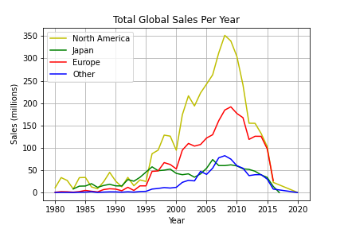
SALES PER YEAR
Sales in North America are higher than anywhere else in the World, and it has been that way since the dawn of video games. Sales everywhere follow very similar trends and really peaked in all regions in 2008.
In 2008, when sales were at their highest, the most popular games released were Mario Kart Wii, Grand Theft Auto IV, Call of Duty: World at War, Super Smash Bros. Brawl, and Guitar Hero: World Tour.
To make this graph, I first grouped all titles together by their release year and then summed the sales for each year according to their region.

Slide 5
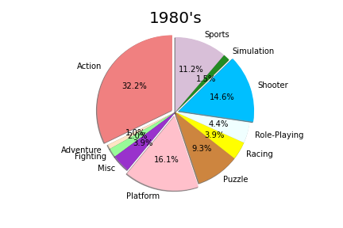
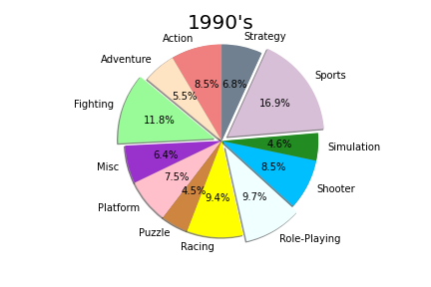
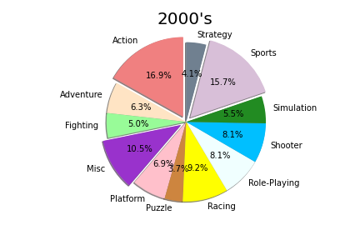
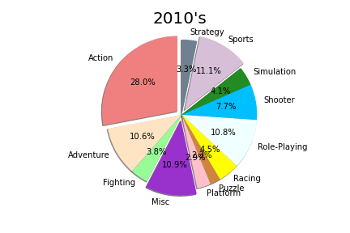
MOST POPULAR GENRES
Action games were the most popular genre in every decade except for the 1990’s when sports took over the top spot.
Sports games were very popular in the 90’s due to big titles such as Tony Hawk’s Pro Skater, Madden NFL, and NBA Jam.
Name | Sales
Tony Hawk's Pro Skater | 5.02
NBA Jam | 3.44
Hot Shots Golf | 2.79
Madden NFL 99 | 2.64
NFL Blitz | 2.56

